Slide 1
Networking
Data Link & Physical Layer - LAN

Slide 2
Physical Layer
The physical layer defines the electrical, mechanical, procedural, and functional specifications for activating, maintaining, and deactivating the physical link between end systems
Actual transmission of data
Movement of bits from the sender to the receiver
Physical characteristics of the media
Physical characteristics of the media interface
Encoding of bits into electrical or optical signals
Synchronisation between the sender and the receiver

Slide 3
Physical Layer
Physical topology – how devices are connected to form a network
Transmission mode – the direction of transmission between devices, i.e. simplex, half – duplex, full duplex.

Slide 4
Synchronisation
The sender and receiver must agree on the transmission rate
  Bit Rate = 1Mbps; Bit Duration = 0.000001 Sec or 1µs
If the sender sends the bits using its own internal clock to govern when bits are transmitted
The receiver samples the transmission media once every bit time (every 1 µs)
  Using its own clock!
In a digital transmission, the receivers' clock is 0.1 percent faster than the sender clock. How many extra bits does the receiver receive if the data rate is 1 Mbps?

Slide 5
Solutions
Asynchronous transmission – send short blocks of data,
  Sender & receiver can re-synchronise after each block
  Block = 1 character
Synchronous transmission – transmit large blocks rather than single characters
    Still need to synchronise sender and receiver
      Separate clock line
      SYN character(s) at the start of the block to synchronise sender and receiver
      Embed the clock in the signal

Slide 6
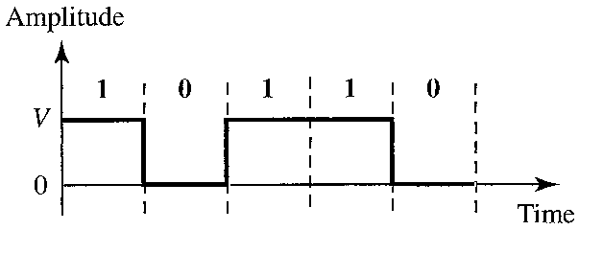
Signals
Data rate = number of bits sent in 1 second
Signal rate = number of signal elements sent in 1 second
Examples
  Non-return to Zero (NRZ)
    Unipolar scheme
    +ive voltage = 1, no voltage = 0
    Voltage doesn’t return to zero during bit transmission

Slide 7
More Examples
NRZ – L
  Polar Scheme
  +ive voltage = 0, -ive voltage = 1
  Voltage doesn’t return to zero during bit transmission
  Receiver interprets level of voltage to determine bit value
NRZ – I
  Polar Scheme
  Uses presence or absence of transitions at the start of the bit to determine bit value
    Presence = 1
    Absence = 0
  Voltage doesn’t return to zero during bit transmission
  Bit value is NOT determined by voltage level

Slide 8
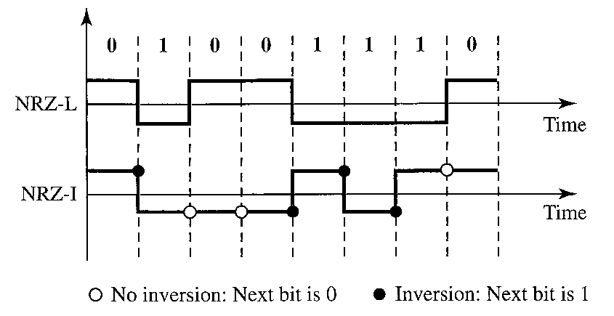
NRZ – L & NRZ - I

Slide 9
Manchester Encoding
+ive / -ive voltages
Mid – bit transition during each bit interval
  Clocking / synchronisation
  Data
    Binary 1 = low to high transition
    Binary 0 = high to low transition

Slide 10
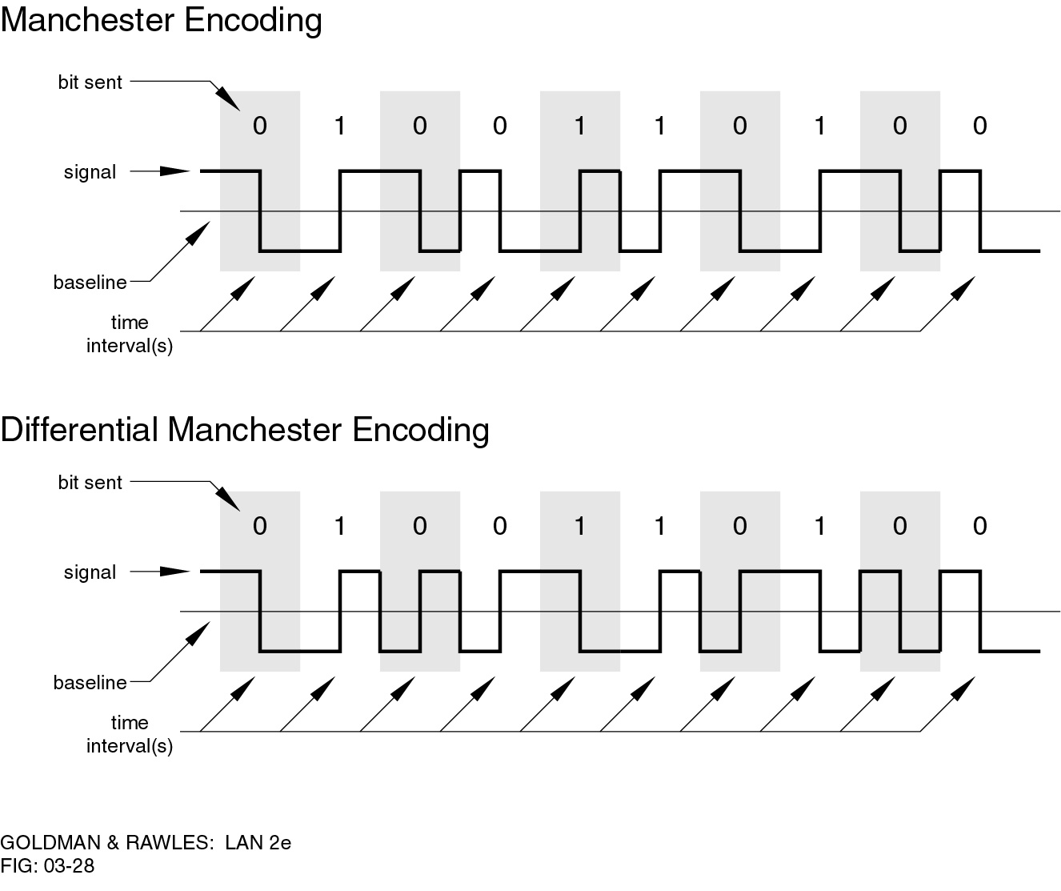
Manchester Encoding

Slide 11
Differential Manchester Encoding
+ive / -ive voltages
Mid – bit transition during each bit interval
  Clocking / synchronisation only
Uses presence or absence of transitions at the start of the bit to determine bit value
    Presence = 0
    Absence = 1

Slide 12
Differential Manchester Encoding

Slide 13
Network Topology
Defines how the network is structured – Physical Topology and how the devices on the network communicate – Logical Topology
Physical Topology – structure or the physical arrangement of network devices, how the components of the network are connected.
  May also include specific device location such as room number and location on the equipment rack
  LAN – Star, Extended Star, Hybrid, Legacy (Bus, Ring)
  WAN – Point-to-point, hub and spoke, mesh

Slide 14
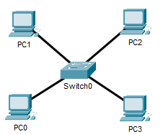
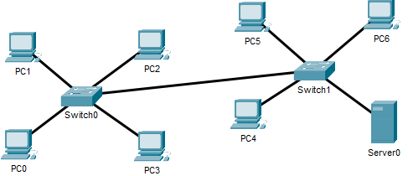
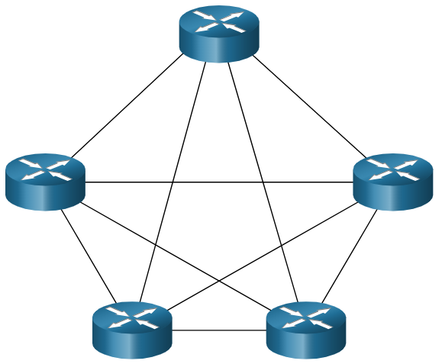
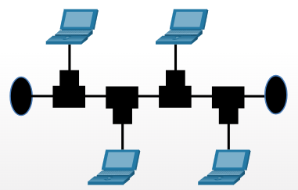

Physical Topologies
Star Topology
Extended Star Topology
Point-to-point
Mesh
Bus

Slide 15
Logical Topology
Describes how the devices in the network communicate with each other and how data is transmitted
  Broadcast
  Token passing
Logical Topology diagram refers to the way a network transfers frames from one node to the next
  This topology identifies virtual connections using device interfaces and Layer 3 IP addressing schemes.

Slide 16


Transmission Modes
Simplex is 1-way only, e.g. from the PC (transmit) to the projector (receive)
Half Duplex means that both devices can transmit and receive but not at the same time
  Legacy Ethernet LAN’s and Wireless LAN’s
Full Duplex means that both devices can transmit and receive at the same time

Slide 17
Data Link Layer
Framing data & frame synchronisation
Physical addressing
Flow control
Error control
Congestion Control

Slide 18
Framing
Encapsulates the network layer datagram e.g. IP packet or ARP request
The frame format depends on the technology being used
  A wired Ethernet frame will have a different format to a Wireless Ethernet frame
Frame size depends on the payload
  MTU (Maximum Transmission Unit) – limit on the maximum payload
  Large frames have a higher probability of error
  Variable sized frames or fixed sized cells
  Must be able to identify the beginning & end of the frame

Slide 19
Addresses
Frames will contain addresses (physical, MAC, hardware)
The addresses can be:
  Unicast – 1 receiver
  Multicast – group
  Broadcast – all devices
The source address MUST be unicast
The destination address can be unicast, multicast, broadcast

Slide 20
Flow Control
Limiting/controlling the rate at which data is sent
  Controlled by the receiver
Mentioned at both the data link layer and the transport layer
Can be implemented at the data link layer
  Ethernet does implement flow control, but it’s not widely deployed (pause frame)
More common in the transport layer (TCP)

Slide 21
Congestion Control
Congestion = too much traffic on the network
Congestion control mentioned in the data link layer
  Not really implemented at data link layer
  More common at network and transport layer
    End-to-end

Slide 22
Errors
Applications require guaranteed data delivery
Errors can cause: -
  Data to be received incorrectly
  Data to be lost
  Unwanted data to be generated
Sources of Errors include:
  Impulse Noise
  White Noise
  Attenuation
  CrossTalk
  Delay Distortion
  Line Failure

Slide 23
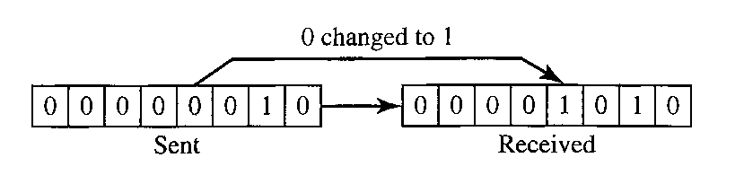
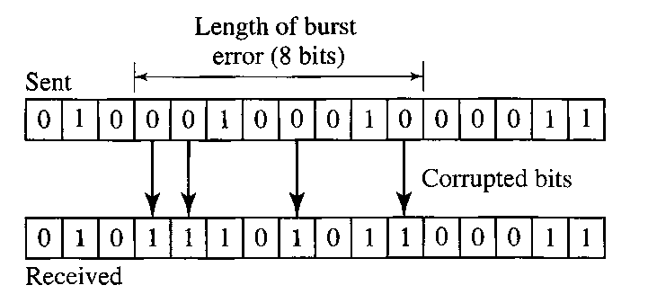
Types of Errors
Single bit errors
Burst errors

Slide 24
Approaches to Error Handling
Prevention
  Reduce noise / interference
Detection
  Redundancy
    Parity checks / Cyclical Redundancy Check (CRC)
Control
  Error correction
  Forward error correction
  Retransmission

Slide 25
Cyclical Redundancy Check (CRC)
Data ÷ predetermined binary number = CRC
  CRC = remainder or redundant bits
  Remainder is added to data before transmission
Data + CRC is evenly divisible by the predetermined binary number
At its destination, the incoming data + CRC is divided by the same number
  Remainder = 0 → no error

Slide 26
Polynomial Generator
A Polynomial Generator is used to calculate the binary divisor e.g. x⁴ + x² +1
Binary devisor = predetermined binary number

Slide 27
Polynomial Generator - Examples
Name | Polynomial | Application
CRC – 8 | x⁸ + x² +x +1 | ATM
CRC – 10 | x¹⁰ + x⁹ + x⁵ + x⁴ + x² +1 | ATM AAL
CRC – 16 | x¹⁶ + x¹² + x⁵ +1 | HDLC
CRC – 32 | x³² + x²⁶ + x²³ + x²² + x¹⁶ + x¹² + x¹¹ + x¹⁰ + x⁸ + x⁷ + x⁵ + x⁴ + x² +x +1 | LAN’s (Ethernet)

Slide 28
Steps (Transmitter)
Convert Polynomial Generator to binary
Data is created.
A Frame Check Sequence (FCS) is generated.
The data + the FCS are divided by the polynomial divisor using binary division
The remainder resulting from this division is the CRC
The data unit + the CRC is sent on the transmission line

Slide 29
Steps (Receiver)
The receiver divides data & CRC by the same polynomial divisor that was used to find the CRC
If the string arrives without error, the CRC checker yields a 0 and the data unit passes
If the string arrives with an error, the CRC checker yields a non-zero remainder, and the data is rejected

Slide 30
CRC - Example
Data = 11011
Polynomial Generator = x⁴ + x² +1
Step 1
Step 2
X⁴ | X³ | X² | X¹ | X⁰
1 | 0 | 1 | 0 | 1
Data | FCS
11011 | 0000

Slide 31
CRC – Example (Cont’d)
Bit 1 | Bit 2 | XOR
0 | 0 | 0
0 | 1 | 1
1 | 0 | 1
1 | 1 | 0

Slide 32
CRC – Example (Cont’d)
The CRC is 1001
This is appended to the original data
The transmitted data stream becomes 110111001

Slide 33
CRC Performance
Effective
Burst errors
Odd number of bits
99.97%

